Slide 1
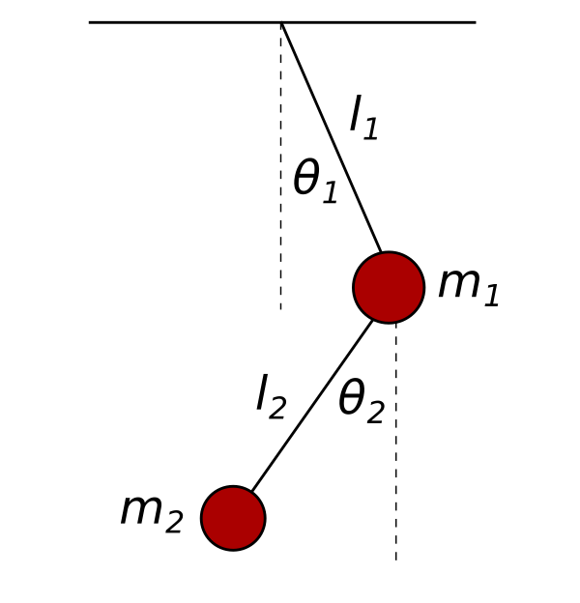
DOUBLE PENDULUM
CLASSICAL MECHANICS
BY ADITYA SINGH 2K19/EP/005

Slide 2
ASSUMPTIONS
Each pendulum consists of a point mass m hanging on an ideal ( non-elastic, mass-less) string of length l in a constant, homogeneous gravitational field of acceleration g. While the first pendulum is attached to a rigid, motionless point, the second pendulum is attached to the point mass of the first one.

Slide 3

NEWTON’S METHOD
https://physicspython.wordpress.com/2019/04/26/double-pendulum-part-2/
However, we still don’t know what the relevant forces are. Of course, there will be the projection of the gravitational force in the angular direction. But there will also be a force due to one of the pendulums pulling on the other one. And we expect this force to not only depend on both the angles, but also on their velocities.
It appears that this method is not a very efficient in terms of formulating the equation of motion of this system.

Slide 4

Euler-Lagrange Method
The trajectory of the system must then satisfy the Euler-Lagrange equation of motion (EoM):

Slide 5
First, let us write down the horizontal and vertical cartesian coordinates in terms of the relevant degrees of freedom.
Differentiating the cartesian coordinates, we get velocities as,

Slide 6


Slide 7




Slide 8



HAMILTONIAN FORMALISM

Slide 9
The Hamiltonian is a function of the coordinates and . We must express and as functions of generalized positions and momenta. To that end, we isolate

Slide 10

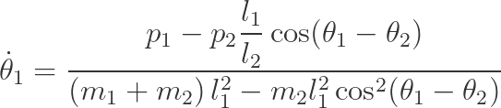


Slide 11



We finally arrive at Hamilton’s equations of motion:

Slide 12
PYTHON SIMULATION
We will assume that the lengths of the two pendulums are identical and equal to one, l₁= l₂ = 1 . We will also set the masses to m₁= m₂ = 1.
We have chosen to always start from a state in which the initial velocities are zero.
polar_to_cartesian() method takes the current position of the two masses in terms of angles and lengths, and transforms them into Cartesian coordinates (horizontal and vertical positions). The method returns an array of the coordinates corresponding to the pivot, the first, and the second mass of the pendulum, respectively.
FuncAnimation() function from the animation module of the matplotlib package.

Slide 13
THANK YOU!

